Slide 1
Chapter 5: Computer Systems Organization
Invitation to Computer Science,
C++ Version, Fourth Edition
Updated on 1 April 2009*

Slide 2
Objectives
In this chapter, you will learn about
The components of a computer system
Putting all the pieces together—the Von Neumann architecture
Non-Von Neumann architectures
Invitation to Computer Science, C++ Version, Fourth Edition

Slide 3
Introduction
Computer organization examines the computer as a collection of interacting “functional units”
Functional units may be built out of the circuits already studied
Higher level of abstraction assists in understanding by reducing complexity
Invitation to Computer Science, C++ Version, Fourth Edition

Slide 4
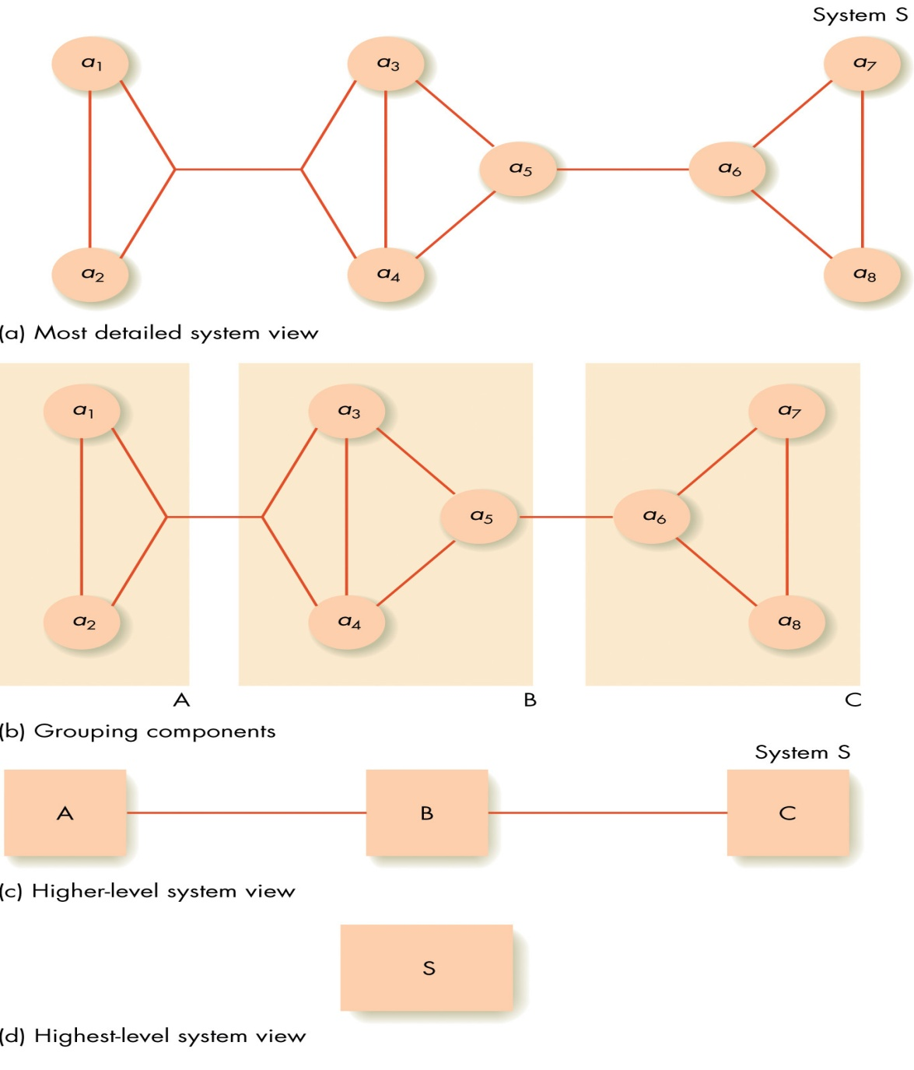
Figure 5.1
The Concept of Abstraction
Invitation to Computer Science, C++ Version, Fourth Edition

Slide 5
The Components of a Computer System
Von Neumann architecture has four functional units
  Memory
  Input/Output
  Arithmetic/Logic unit
  Control unit
Sequential execution of instructions
Stored program concept
Invitation to Computer Science, C++ Version, Fourth Edition

Slide 6
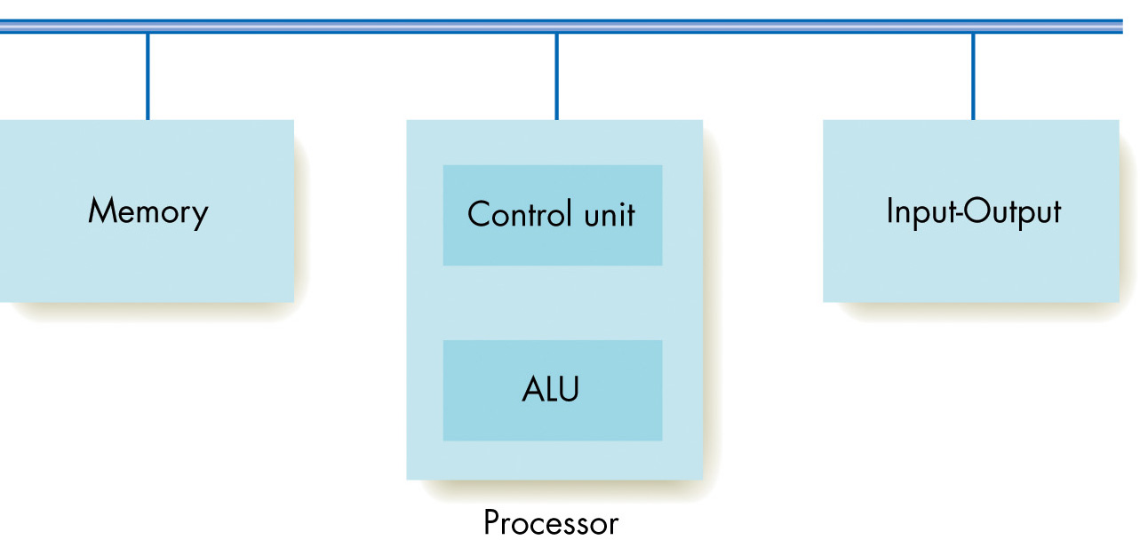
Figure 5.2
Components of the Von Neumann Architecture
Invitation to Computer Science, C++ Version, Fourth Edition

Slide 7
Computer Organization*
Logical organization of computer
Memory
Input
CPU
Output
ALU
Secondary
Storage
Invitation to Computer Science, C++ Version, Fourth Edition

Slide 8
Memory and Cache
Information stored and fetched from memory subsystem
Random access memory maps addresses to memory locations
Cache memory keeps values currently in use in faster memory to speed access times
Invitation to Computer Science, C++ Version, Fourth Edition

Slide 9
Memory and Cache (continued)
RAM (random access memory)
  Memory made of addressable cells
  Current standard cell size is 8 bits
  All memory cells accessed in equal time
  Memory address
    Unsigned binary number N long
    Address space is then 2^{N} cells
Invitation to Computer Science, C++ Version, Fourth Edition

Slide 10
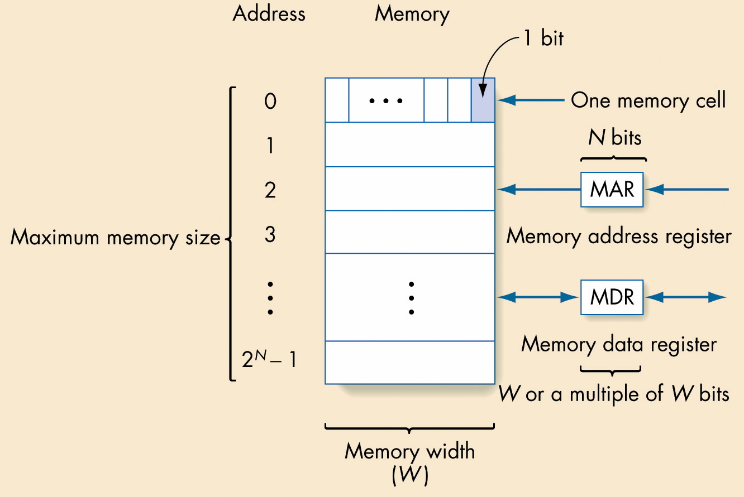
Figure 5.3
Structure of Random Access Memory
Invitation to Computer Science, C++ Version, Fourth Edition

Slide 11
Memory and Cache (continued)
Parts of the memory subsystem
  Fetch/store controller
    Fetch: Retrieve a value from memory
    Store: Store a value into memory
  Memory address register (MAR)
  Memory data register (MDR)
  Memory cells with decoder(s) to select individual cells
Invitation to Computer Science, C++ Version, Fourth Edition

Slide 12
Memory and Cache (continued)
Fetch operation
  The address of the desired memory cell is moved into the MAR
  Fetch/store controller signals a fetch, accessing the memory cell
  The value at the MAR’s location flows into the MDR
Invitation to Computer Science, C++ Version, Fourth Edition

Slide 13
Memory and Cache (continued)
Store operation
  The address of the cell where the value should go is placed in the MAR
  The new value is placed in the MDR
  Fetch/store controller signals a store, copying the MDR’s value into the desired cell
Invitation to Computer Science, C++ Version, Fourth Edition

Slide 14
Memory and Cache (continued)
Memory register
  Very fast memory location
  Given a name, not an address
  Serves some special purpose
  Modern computers have dozens or hundreds of registers
Invitation to Computer Science, C++ Version, Fourth Edition

Slide 15
Powers of Two*
2¹⁰ | 1K =1,024 | kilo | 10³ ^{1,000}
2²⁰ | 1M=1,048,576 | mega | 10⁶ ^{1,000,000}
2³⁰ | 1G=1,07,741,824 | giga | 10⁹ ^{1,000,000,000}
2⁴⁰ | 1T=1,099,511,627,776 | tera | 10¹² ^{1,000,000,000,000}
2⁵⁰ | 1P=1,125,899,906,842,624 | peta | 10¹⁵
Invitation to Computer Science, C++ Version, Fourth Edition

Slide 16
Powers of Two*
2¹⁰ | 1K =1,024 10³=1,000 | kilo | 10³ ^{1,000}
2²⁰ | 1M=1,048,576 1,000,000 | mega | 10⁶ ^{1,000,000}
2³⁰ | 1G=1,07,741,824 1,000,000,000 | giga | 10⁹ ^{1,000,000,000}
2⁴⁰ | 1T=1,099,511,627,776 1,000,000,000,000 | tera | 10¹² ^{1,000,000,000,000}
2⁵⁰ | 1P=1,125,899,906,842,624 1,000,000,000,000,000 | peta | 10¹⁵
Invitation to Computer Science, C++ Version, Fourth Edition

Slide 17
Powers of 10 as text
# Bytes | Base 10 value | Amt of text
1 byte | 10⁰ | 1 character
1 kilobyte (thousand) | 10³ | 1 typed page
1 megabyte (million) | 10⁶ | 2-3 novels
1 gigabyte (billion) | 10⁹ | Dept. library
1 terabyte (trillion) | 10¹² | University library
1 petabyte (quadrillion) | 10¹⁵ | All libraries. In N. America
1 exabyte (quintillion) | 10¹⁸ | All words ever printed in history
1 zettabyte (hexillion) | 10²¹ | -
1 yottabyte (heptillion) | 10²⁴ | -
Invitation to Computer Science, C++ Version, Fourth Edition

Slide 18
Some sizes dictated by the structure of main memory*
With our instruction having the form of
4 bits for the op code
12 bits for the address
if we plan to have one instruction per memory cell, then we need to have for our computer
An MAR (memory address register) of 12 bits.
A memory size of at most 2¹² = 2²* 2¹⁰ = 4K
A memory width of 4 + 12 = 16 bits
If MDR (memory data register) is 16 bits, then the largest sized number is
0111 1111 1111 1111₂= 2¹⁵ -1 = 32,768.
Invitation to Computer Science, C++ Version, Fourth Edition

Slide 19
Other Components of Memory Unit*
Besides the Random Access Memory and the MAR and MDR, two other components exist:
1) Fetch/store controller: Sends a signal to Fetch or Store
2) Memory decoder circuits: (Ref, Chpt 4, pg 180-182)
A N x 2^{N} decoder has N input lines and 2^{N} output lines.
When the N input lines are set to 0s or 1s and the N values are interpreted as a binary number, they represent all the numbers between 0 and 2^{N}-1.
The output to the decoder is a 1 on the line identified by the value of the input and a 0 on all the other lines.
Invitation to Computer Science, C++ Version, Fourth Edition

Slide 20
Example*
0
1
1
3 x 8 decoder
011₂ = 3 so the line labeled 3, the 4th from the top outputs a 1 and all other lines output a 0.
A decoder selects one line for a pulse, when the input lines are interpreted as a binary number.
Why is this useful for a memory unit?
Invitation to Computer Science, C++ Version, Fourth Edition

Slide 21
Using the Decoder Circuit to Select Memory Locations*
MAR
0
1
2
3
4
5
6
7
•
•
•
15
0 1 1 1
0
4 x 2⁴ decoder
0
1
0
0
Invitation to Computer Science, C++ Version, Fourth Edition

Slide 22
The Decoder Circuit*
Decoder: can be built from AND-OR-NOT gates
See Figure 4.29 on page 181 for a 2 x 4 decoder circuit.
As with all circuits, to build a decoder,
1) Build a truth table for the circuit
(For example, for a 3 x 8 decoder, there are 8 rows, 3 input choices, and 8 output values).
2) Use the sum-of-products algorithm to find the Boolean expression for the truth table.
3) Build the circuit.
Invitation to Computer Science, C++ Version, Fourth Edition

Slide 23
The decoder circuit doesn't scale well--- i.e. as the number of bits in the MAR increases, the number of output lines for the decoder goes up exponentially.
Most computers today have an MAR of 32 bits. Thus, if the memory was laid out as we showed it, we would need a 32 x 2³² decoder!
Note 2³² is 2² 2³⁰ = 4 G
So most memory is not 1 dimensional, but 2-dimensional (or even 3-dimensional if banked memory is used).
Invitation to Computer Science, C++ Version, Fourth Edition

Slide 24
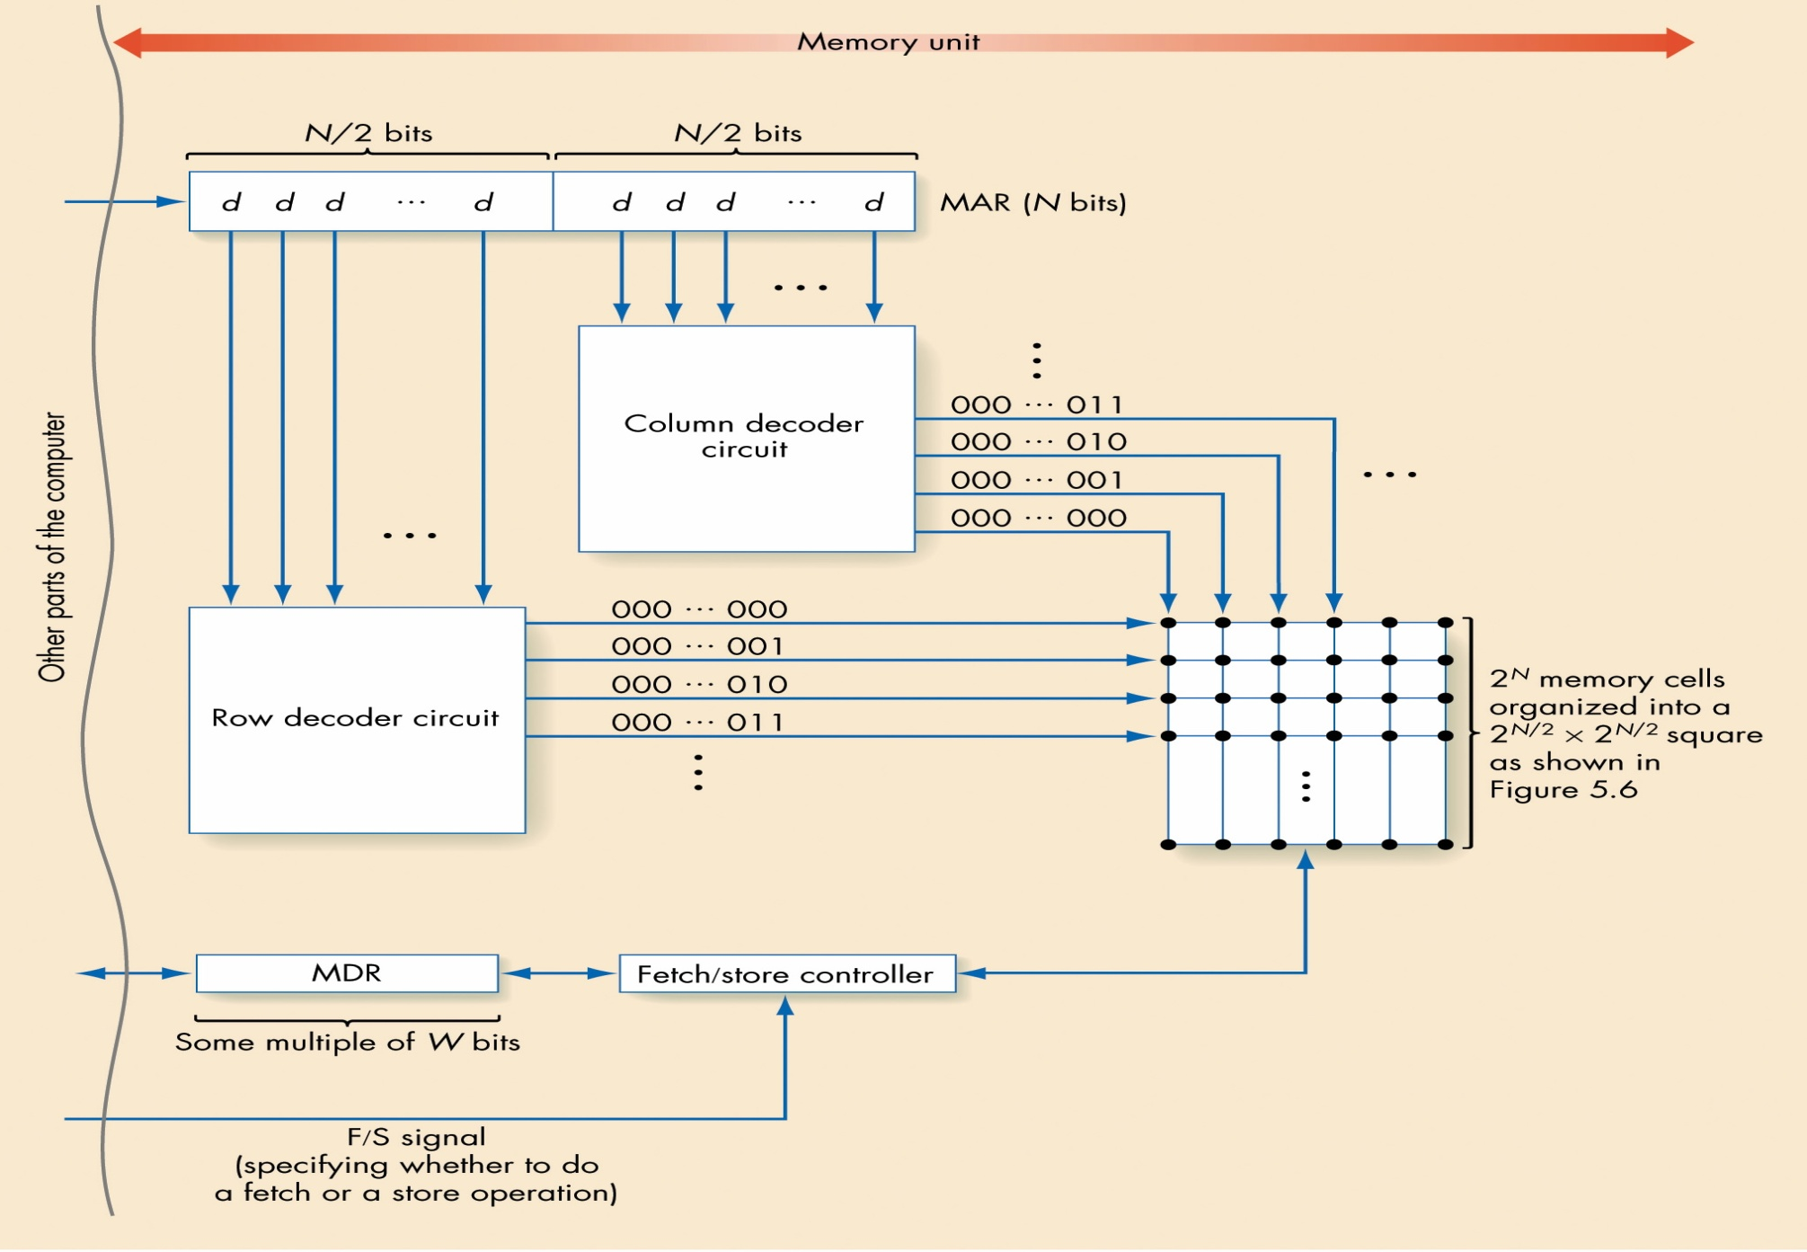
Figure 5.7
Overall RAM Organization
Invitation to Computer Science, C++ Version, Fourth Edition

Slide 25
2-D MEMORY*
MAR
0 1 1 1
Note that a 4 x 16 decoder was used for the 1-D memory.
2 x 4
decoder
columns
2 x 4
decoder
rows
Invitation to Computer Science, C++ Version, Fourth Edition

Slide 26
Cache Memory
Memory access is much slower than processing time
Faster memory is too expensive to use for all memory cells
Locality principle
  Once a value is used, it is likely to be used again
Small size, fast memory just for values currently in use speeds computing time
Invitation to Computer Science, C++ Version, Fourth Edition

Slide 27
Input/Output and Mass Storage
Communication with outside world and external data storage
  Human interfaces: Monitor, keyboard, mouse
  Archival storage: Not dependent on constant power
External devices vary tremendously from each other
Invitation to Computer Science, C++ Version, Fourth Edition

Slide 28
Input/Output and Mass Storage (continued)
Volatile storage
  Information disappears when the power is turned off
  Example: RAM
Nonvolatile storage
  Information does not disappear when the power is turned off
  Example: Mass storage devices such as disks and tapes
Invitation to Computer Science, C++ Version, Fourth Edition

Slide 29
Input/Output and Mass Storage (continued)
Mass storage devices
  Direct access storage device
    Hard drive, CD-ROM, DVD
    Uses its own addressing scheme to access data
  Sequential access storage device
    Tape drive
    Stores data sequentially
    Used for backup storage these days
Invitation to Computer Science, C++ Version, Fourth Edition

Slide 30
Input/Output and Mass Storage* (continued)
Direct access storage devices
  Data stored on a spinning disk
  Disk divided into concentric rings (sectors)
  Read/write head moves from one ring to another while disk spins
  Access time depends on
    Time to move head to correct sector (track): Seek time
    Time for sector to spin to data location: Latency
Invitation to Computer Science, C++ Version, Fourth Edition

Slide 31
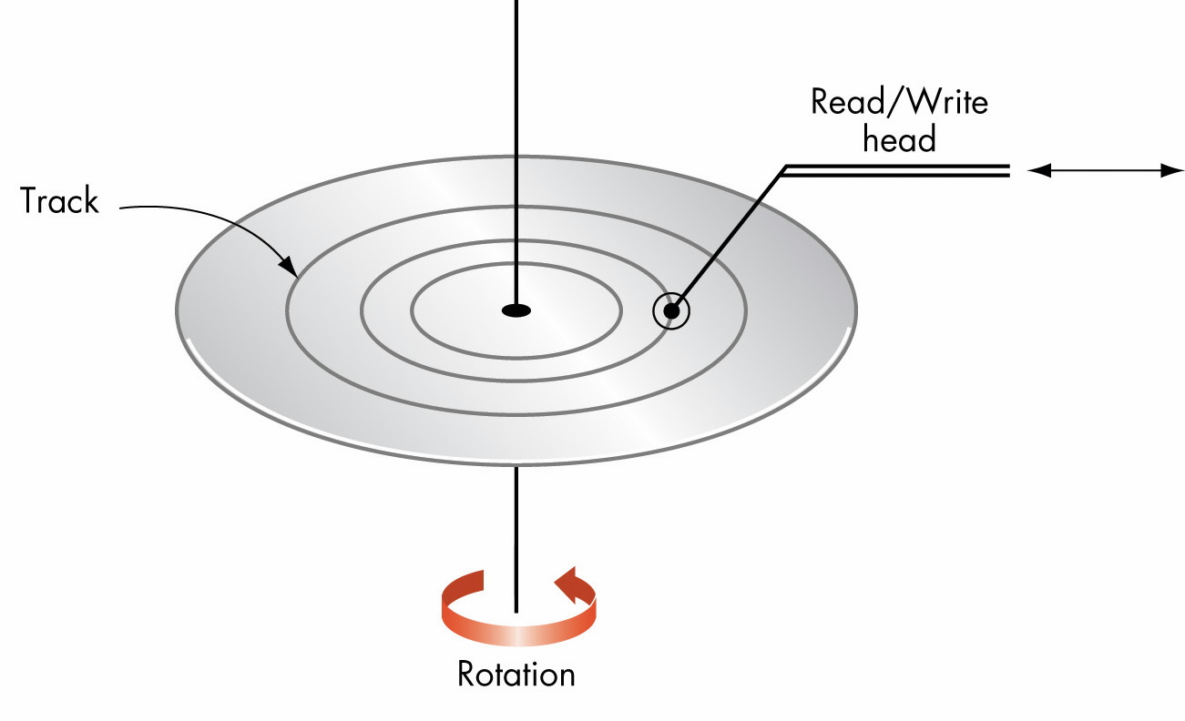
Figure 5.8
Overall Organization of a Typical Disk
Invitation to Computer Science, C++ Version, Fourth Edition

Slide 32
Input/Output and Mass Storage (continued)
I/O controller
  Intermediary between central processor and I/O devices
  Processor sends request and data, then goes on with its work
  I/O controller interrupts processor when request is complete
Invitation to Computer Science, C++ Version, Fourth Edition

Slide 33
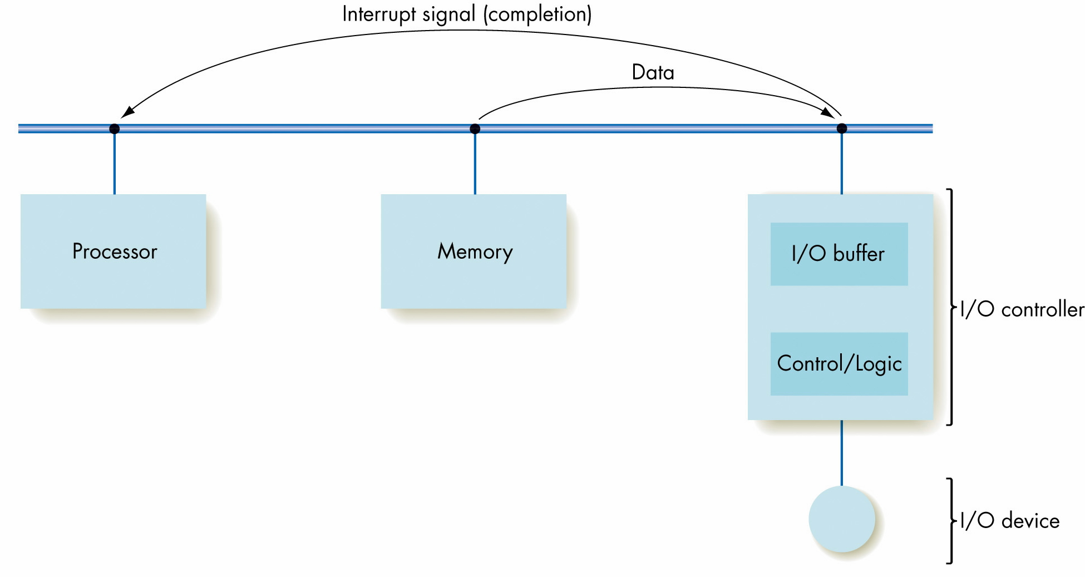
Figure 5.9
Organization of an I/O Controller
Invitation to Computer Science, C++ Version, Fourth Edition

Slide 34
The Arithmetic/Logic Unit*
Arithmetic and Logic Unit
  “Manufacturing” section of computer
  Contains decision mechanisms and can make comparisons
Actual computations are performed
Primitive operation circuits
  Arithmetic [+, -, *, /]
  Comparison [equality or CE, GT, LT, NEQ]
  Logic [AND, OR, NOT, XOR] Data inputs and results stored in registers
Multiplexor selects desired output
Invitation to Computer Science, C++ Version, Fourth Edition

Slide 35
The Arithmetic/Logic Unit (continued)
ALU process
  Values for operations copied into ALU’s input register locations
  All circuits compute results for those inputs
  Multiplexor selects the one desired result from all values
  Result value copied to desired result register
Invitation to Computer Science, C++ Version, Fourth Edition

Slide 36
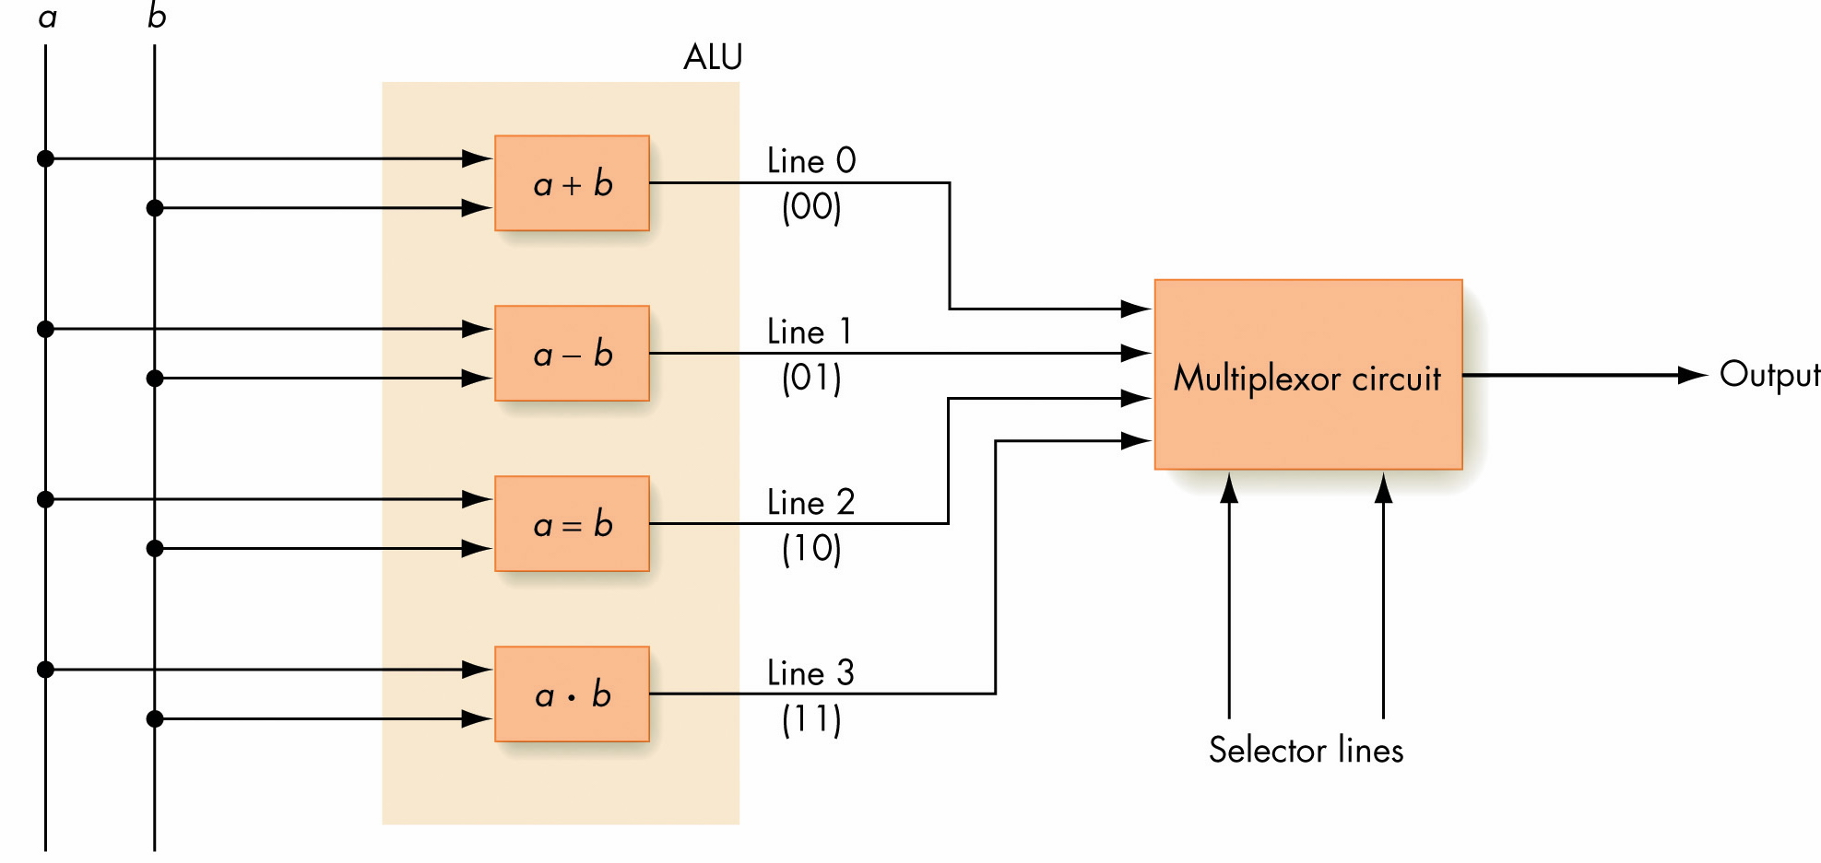
Figure 5.12
Using a Multiplexor Circuit to Select the Proper ALU Result
Invitation to Computer Science, C++ Version, Fourth Edition

Slide 37
The Control Unit
Manages stored program execution
Task
  Fetch from memory the next instruction to be executed
  Decode it: Determine what is to be done
  Execute it: Issue appropriate command to ALU, memory, and I/O controllers
Invitation to Computer Science, C++ Version, Fourth Edition

Slide 38
Machine Language Instructions
Can be decoded and executed by control unit
Parts of instructions
  Operation code (op code)
    Unique unsigned-integer code assigned to each machine language operation
  Address fields
    Memory addresses of the values on which operation will work
Invitation to Computer Science, C++ Version, Fourth Edition

Slide 39

Figure 5.14
Typical Machine Language Instruction Format
Invitation to Computer Science, C++ Version, Fourth Edition

Slide 40
Machine Language Instructions*
 | Instruction | Binary Op Code | Meaning
0 | Load | 0000
1 | Store | 0001
2 | Clear | 0010
3 | Add | 0011
4 | Increment | 0100
5 | Subtract | 0101
6 | Decrement | 0110
7 | Compare | 0111
8 | Jump | 1000
9 | Jump GT | 1001
10 | Jump EQ | 1010
11 | Jump LT | 1011
12 | Jump NEQ | 1100
13 | In | 1101
14 | Out | 1110
15 | Halt | 1111
Invitation to Computer Science, C++ Version, Fourth Edition

Slide 41
Machine Language Instructions (continued)
Operations of machine language
  Data transfer operations
    Move values to and from memory and registers
  Arithmetic/logic operations
    Perform ALU operations that produce numeric values
Invitation to Computer Science, C++ Version, Fourth Edition

Slide 42
Machine Language Instructions (continued)
Operations of machine language (continued)
  Compare operations
    Compare two values and set an indicator on the basis of the results of the compare; set register bits
  Branch operations
    Jump to a new memory address to continue processing
Invitation to Computer Science, C++ Version, Fourth Edition

Slide 43
Control Unit Registers and Circuits
Parts of control unit
  Links to other subsystems
  Instruction decoder circuit
  Two special registers
    Program counter (PC)
      Stores the memory address of the next instruction to be executed
    Instruction register (IR)
      Stores the code for the current instruction
Invitation to Computer Science, C++ Version, Fourth Edition

Slide 44
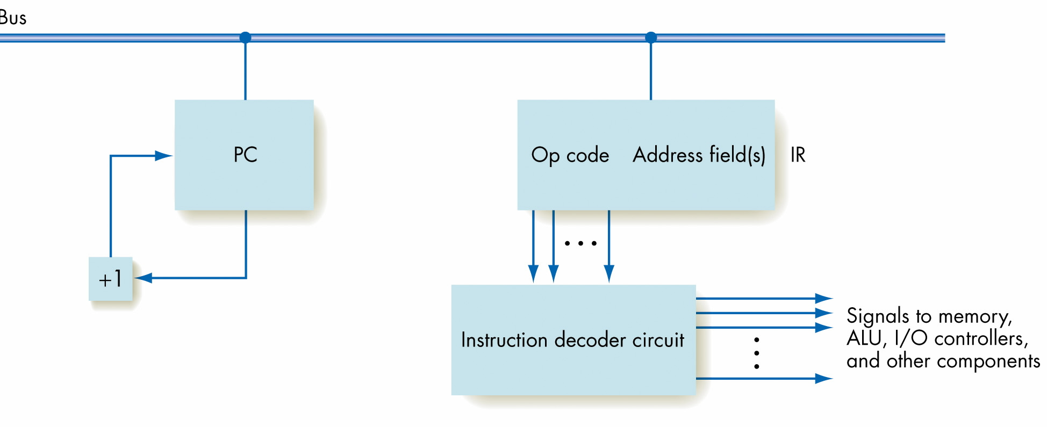
Figure 5.16
Organization of the Control Unit Registers and Circuits
Invitation to Computer Science, C++ Version, Fourth Edition

Slide 45
Putting All the Pieces Together—the Von Neumann Architecture
Subsystems connected by a bus
  Bus: Wires that permit data transfer among them
At this level, ignore the details of circuits that perform these tasks: Abstraction!
Computer repeats fetch-decode-execute cycle indefinitely
Invitation to Computer Science, C++ Version, Fourth Edition

Slide 46
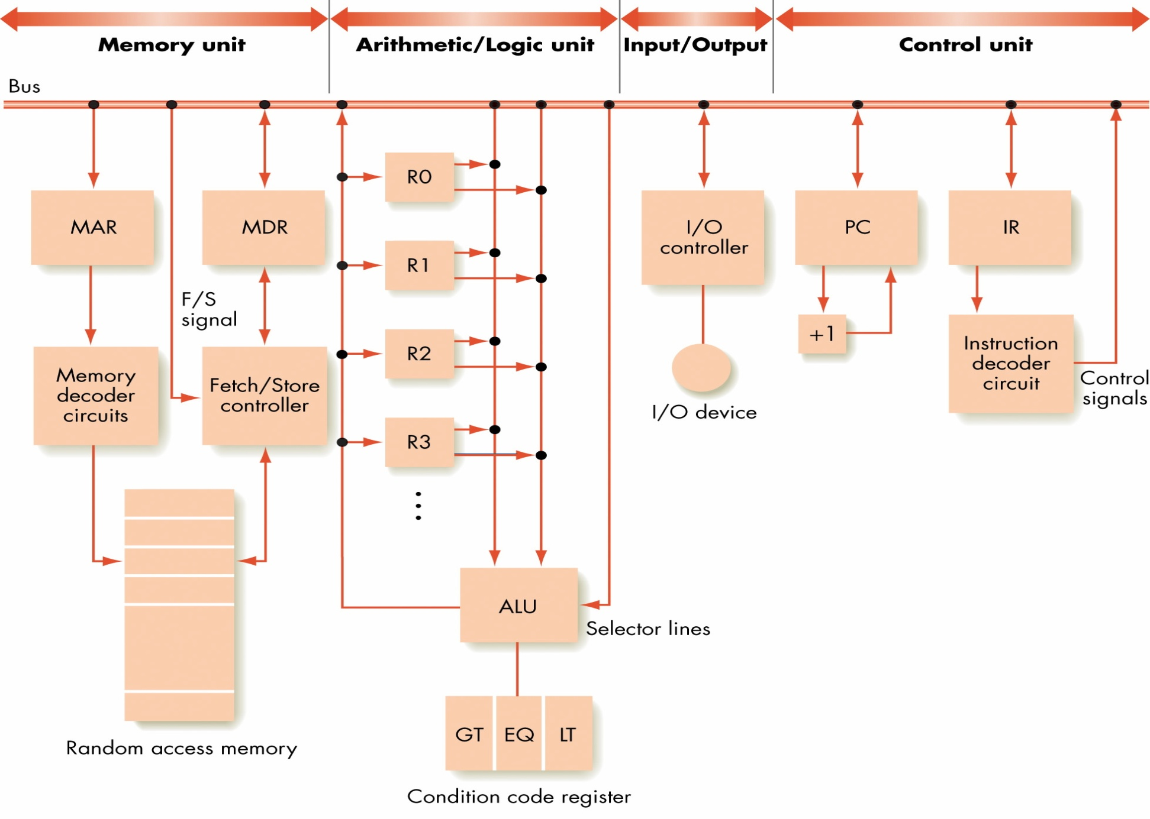
Figure 5.18
The Organization
of a Von Neumann
Computer
Invitation to Computer Science, C++ Version, Fourth Edition

Slide 47
Non-Von Neumann Architectures
Physical limitations on speed of Von Neumann computers
Non-Von Neumann architectures explored to bypass these limitations
Parallel computing architectures can provide improvements; multiple operations occur at the same time
Invitation to Computer Science, C++ Version, Fourth Edition

Slide 48
Non-Von Neumann Architectures
Parallel Architectures
Physical limitations on speed of Von Neumann computers
Non-Von Neumann architectures explored to bypass these limitations
Parallel computing architectures can provide improvements; multiple operations occur at the same time
Invitation to Computer Science, C++ Version, Fourth Edition

Slide 49
SIMD Parallel Architectures
SIMD architecture
  Single instruction/multiple data
  Multiple processors running in parallel
  All processors execute same operation at one time
  Each processor operates on its own data
  Suitable for vector operations
Invitation to Computer Science, C++ Version, Fourth Edition

Slide 50
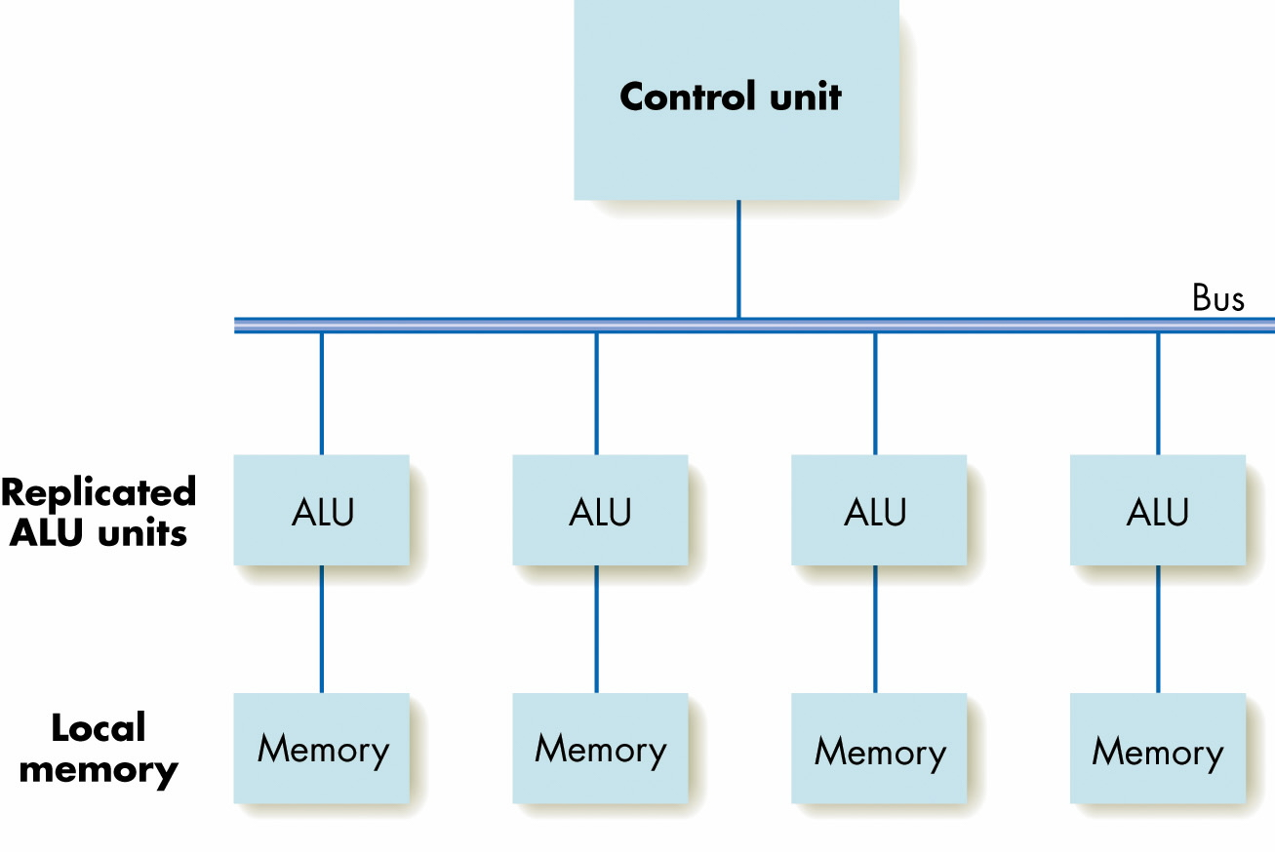
Figure 5.21
A SIMD Parallel Processing System
Invitation to Computer Science, C++ Version, Fourth Edition

Slide 51
Figure 5.21
A SIMD Parallel Processing System
Invitation to Computer Science, C++ Version, Fourth Edition

Slide 52
Associative SIMD
Associative Computer: A SIMD computer with certain additional hardware features.
  Features can be supported (less efficiently) in software by a traditional SIMD
  The name “associative” is due to its ability to locate items in the memory of PEs by content rather than location.
    Uses associative features to simulate an associative memory
The ASC model (for ASsociative Computing) identifies the properties assumed for an associative computer
Invitation to Computer Science, C++ Version, Fourth Edition

Slide 53
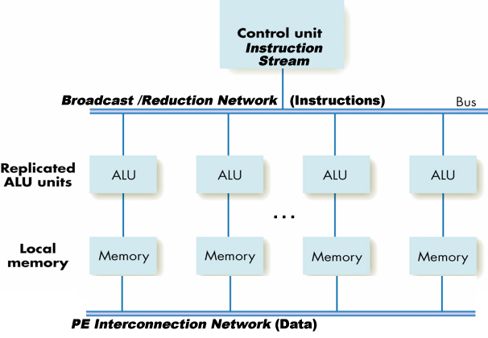
An Associative SIMD Parallel Processing System
(Associative components in italics)
Invitation to Computer Science, C++ Version, Fourth Edition

Slide 54
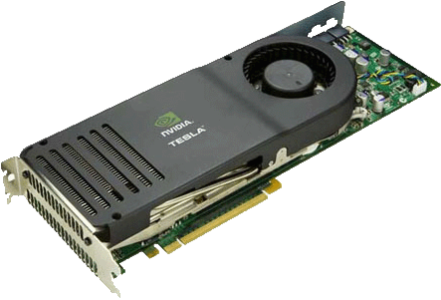
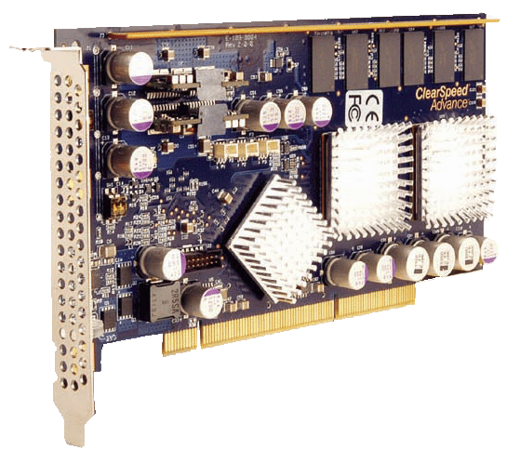
ASC on Metal
ASC
SIMD with Additional Features
Associative
Functions
Associative Search Search via Content, not Memory Address
Associative
Functions
ClearSpeed
“SIMD” Accelerator (64-bit FP)
50 GFLOPS peak performance
25W average power dissipation
NVIDIA Tesla GPGPU
Stream Processor (32-bit FP)
518 Peak GFLOPS on Tesla Series
170W peak, 120W typical
Invitation to Computer Science, C++ Version, Fourth Edition

Slide 55
MIMD Parallel Architectures
MIMD architecture
  Multiple instruction/multiple data
  Multiple processors running in parallel
  Each processor performs its own operations on its own data
  Processors communicate with each other
Invitation to Computer Science, C++ Version, Fourth Edition

Slide 56
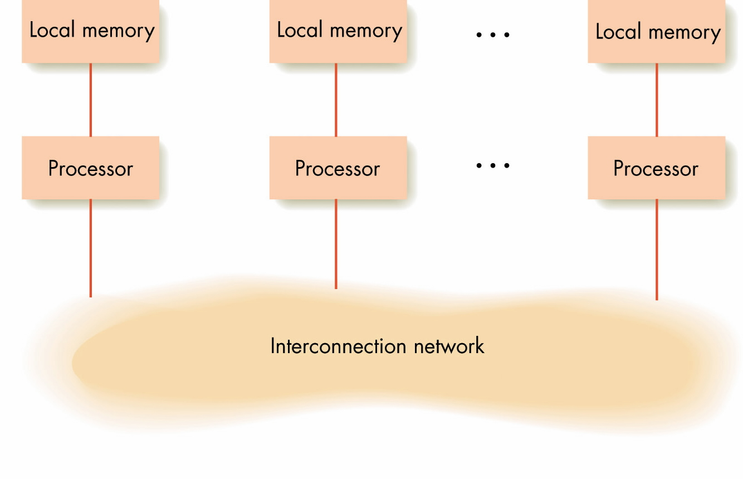
Figure 5.22
Model of MIMD Parallel Processing
Invitation to Computer Science, C++ Version, Fourth Edition

Slide 57
More “flavors” of MIMD architectures - Grid Computing
Grid computing - using homogeneous or heterogeneous systems for a common computational goal
  Thousands of systems that may be separated by long physical distances
  A form of distributed computing like SETI@home and Folding@home
Invitation to Computer Science, C++ Version, Fourth Edition

Slide 58
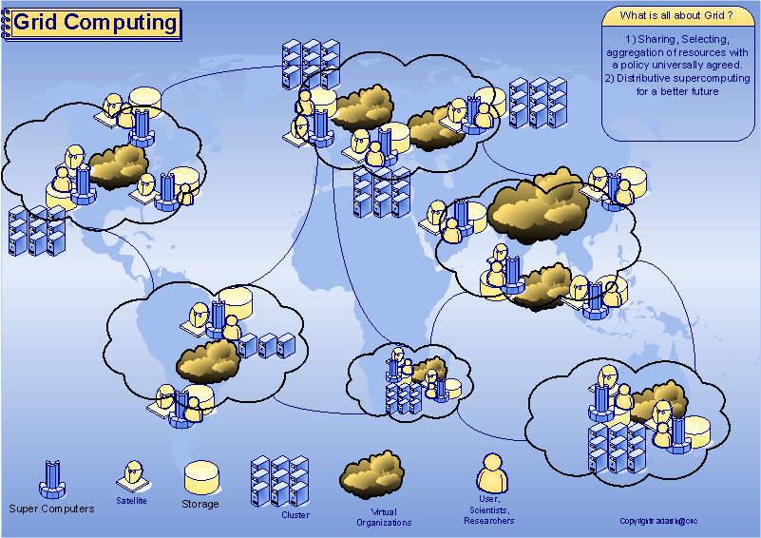
Grid Computing
Image source: http://www.adarshpatil.com/newsite/images/grid-computing.gif
Invitation to Computer Science, C++ Version, Fourth Edition

Slide 59
More “flavors” of MIMD architectures - Cloud Computing
Cloud Computing - Internet or "cloud" based development and computing
  Resources are provided as a service over the Internet.
  Users need no knowledge of, expertise in, or control over the technology used (and usually won’t)
  Amazon Elastic Compute Cloud (Amazon EC2)
  Apple’s Mobile Me / Microsoft’s “Cloud OS” Azure
Invitation to Computer Science, C++ Version, Fourth Edition

Slide 60
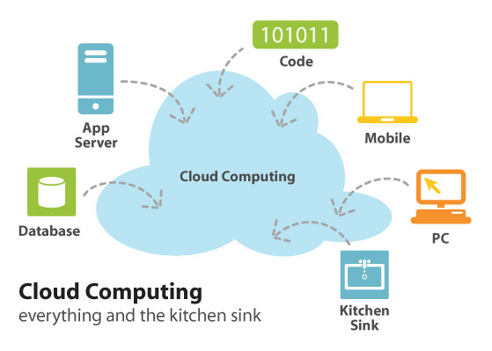
Cloud Computing…Sort of
Image Source: http://infreemation.net/cloud-computing-linear-utility-or-complex-ecosystem/
Invitation to Computer Science, C++ Version, Fourth Edition

Slide 61
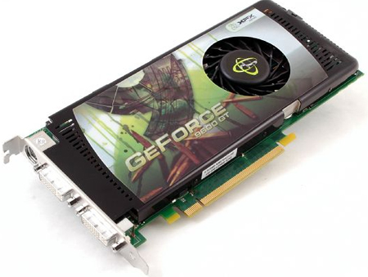
General-purpose Programming on Graphics Processors (GPGPU)
Hybrid MIMD and SIMD computing
Uses the computation power of graphics card for non-graphics applications
NVIDIA C870 Tesla GPGPU
  518 Peak GFLOPS on Tesla
  170W peak, 120W typical
NVIDIA GeForce 9600GT
Invitation to Computer Science, C++ Version, Fourth Edition

Slide 62
Summary of Level 2
Focus on how to design and build computer systems
Chapter 4
  Binary codes
  Transistors
  Gates
  Circuits
Invitation to Computer Science, C++ Version, Fourth Edition

Slide 63
Summary of Level 2 (continued)
Chapter 5
  Von Neumann architecture
  Shortcomings of the sequential model of computing
  Parallel computers
Invitation to Computer Science, C++ Version, Fourth Edition

Slide 64
Summary
Computer organization examines different subsystems of a computer: memory, input/output, arithmetic/logic unit, and control unit
Machine language gives codes for each primitive instruction the computer can perform and its arguments
Von Neumann machine: Sequential execution of a stored program
Parallel computers improve speed by doing multiple tasks at one time
Invitation to Computer Science, C++ Version, Fourth Edition

